Slide 1
UART PROGRAMMING

Slide 2
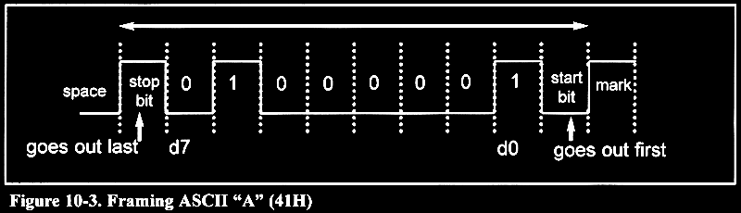
Start and stop bits

Slide 3
UART Configuration registers
PINSEL0
U0LCR
U0DLL
U0DLM
U0LCR
U0LSR

Slide 4
PINSEL0 REGISTER CONFIG – UART0
P0.15 pin sel value
B31
B30
P0.14 pin sel value
P0.13 pin sel value
P0.12 pin sel value
P0.11 pin sel value
P0.10 pin sel value
B29
B28
B27
B26
B25
B24
B23
B22
B21
B20
P0.9 pin sel value
P0.8 pin sel value
P0.7 pin sel value
P0.6 pin sel value
P0.5 pin sel value
B19
B18
B17
B16
B15
B14
B13
B12
B11
B10
P0.4 pin sel value
P0.3 pin sel value
P0.2 pin sel value
P0.1 UART0 Rx B3=0 and B2=1
P0.0 UART0 tx B1=0 and B0 = 1
B9
B8
B7
B6
B5
B4
B3
B2
B1
B0

Slide 5
U0LCR configuration
Divisor latch
Break control
U0LCR.5
Parity selectselect
U0LCR.4
Parity enable
Stop bit select
U0LCR.1
Word length select
U0LCR.0
B7
B6
B5
B4
B3
B2
B1
B0

Slide 6
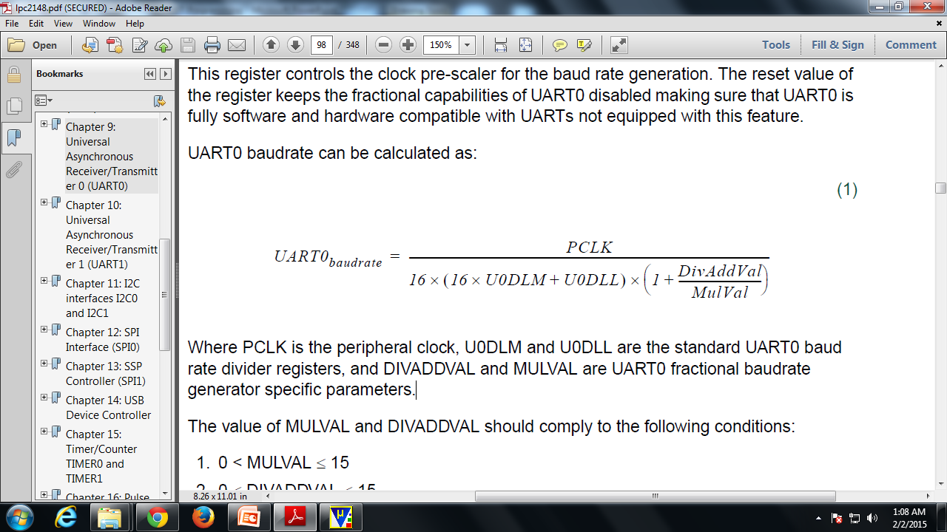
Baud Rate calculating formula – U0DLL and U0DLM

Slide 7
Data transmission and receive – U0LSR
-
TEMP
THRE
BI
FE
PE
OE
RDR
B7
B6
B5
B4
B3
B2
B1
B0

Slide 8
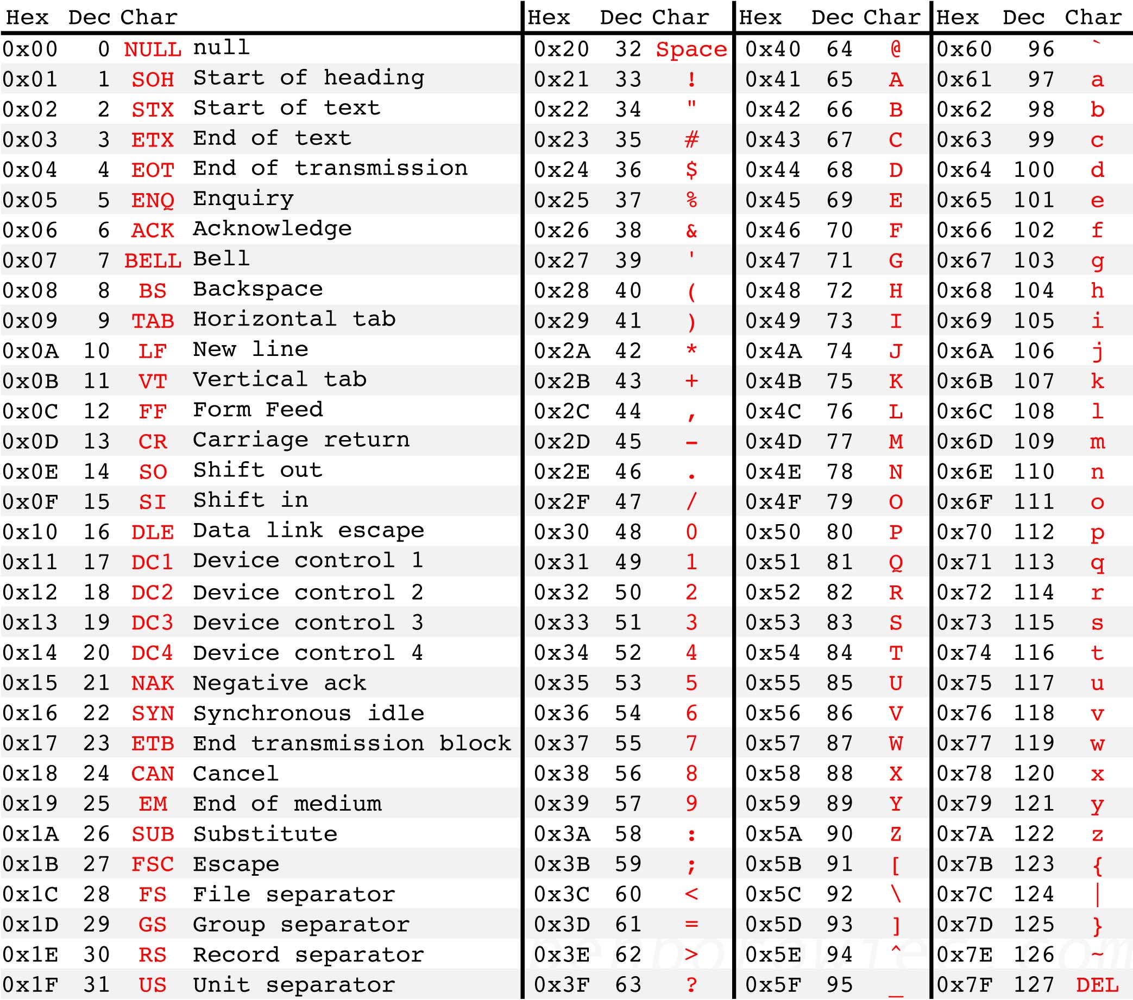
ASCII chart

Slide 9
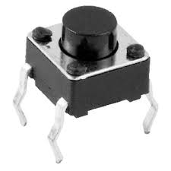

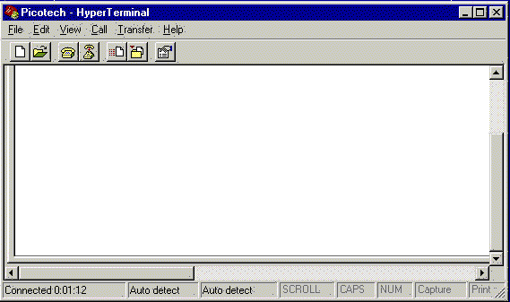
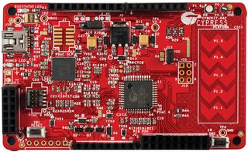
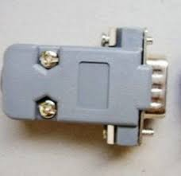
UART demo
1
If(!(IOPIN1 & ( 1 << 16)))
{
U0THR = 0x01;
}
1000000010

